Slide 1


QuickLearning App
Capstone Project
Guided By Professor Henry Wong

Slide 2


Agenda
Accountabilities
Improvements Made
Project Description
Team Working Agreement
Personas
MVP
Technologies
Algorithm
Diagrams
Sprint Recap & Project Recap
Product Backlog
Sprint Backlog
User Stories
Test Cases
Stories Completed and Not Completed
Metrics
Retrospective
Stories Committed for the Next Sprint
Slides App Screenshot
WikiLink
Live Application Demo

Slide 3

Accountabilities

Slide 4
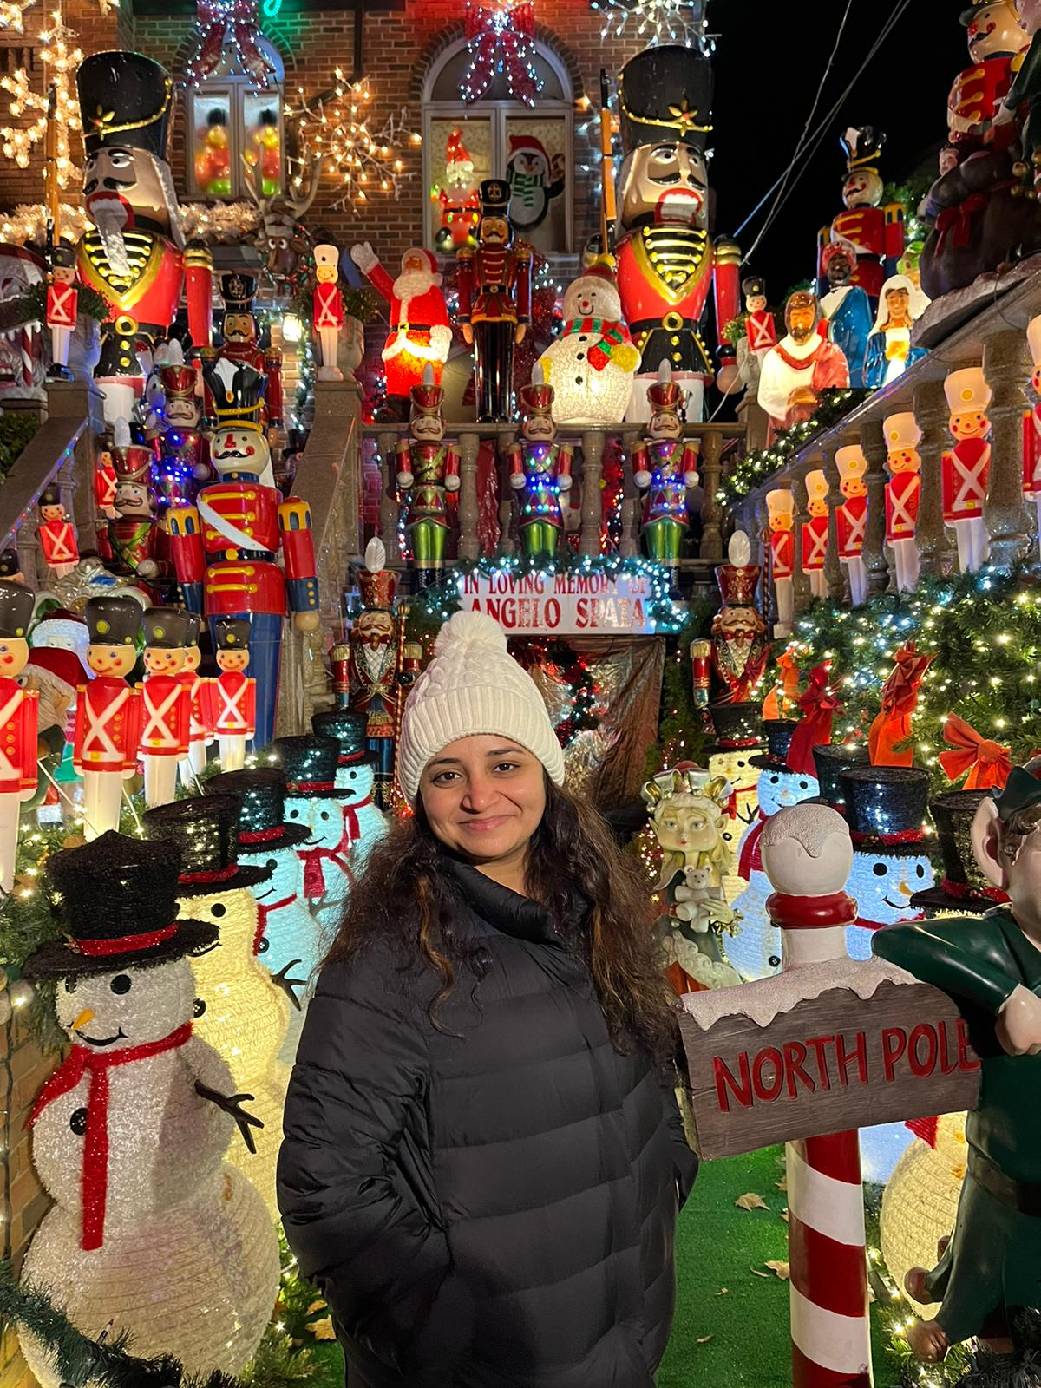


SHARANYA DAVE
Database Administrator
SRAVANI EATA
Software Tester
USHA SRI TIRUMALASETTY
Team Manager

Slide 5


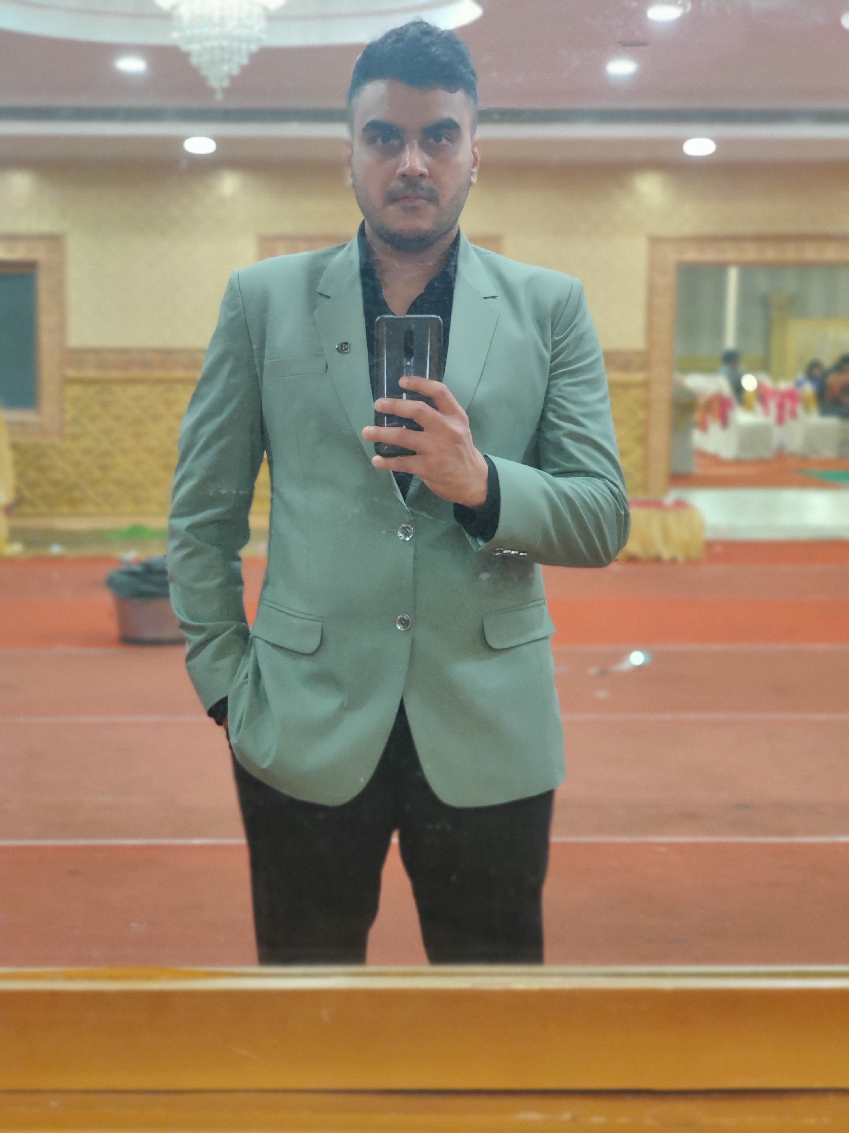
AMIT BHAYAL
Software Developer
ANKUSH RAJESH GURHANI
Software Developer
GENIUS MACHADO
Quality Analyst

Slide 6

Improvements Made
A change in the way metrics were displayed, there was a need for a more effective and efficient way of presenting the slides. By replacing videos with PowerPoint elements, the presentation of metrics has become more engaging and visually appealing, while also providing a better understanding of the data being presented.

Slide 7

Project Description
Quick Learning is a software that is designed specifically to create, distribute, and manage the delivery of educational content.
The Quick Learning application can be hosted as a stand-alone product on the company server, or it can be a cloud-based platform that is hosted by the software firm.
The goal of this project is knowledge management which means gathering, organizing, sharing and analysis of knowledge/resources about a topic in depth.

Slide 8
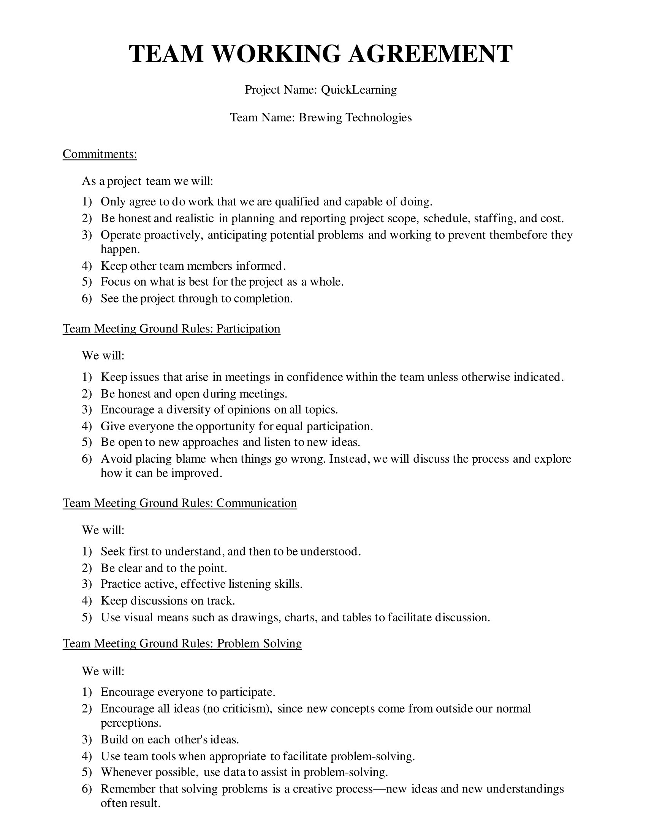
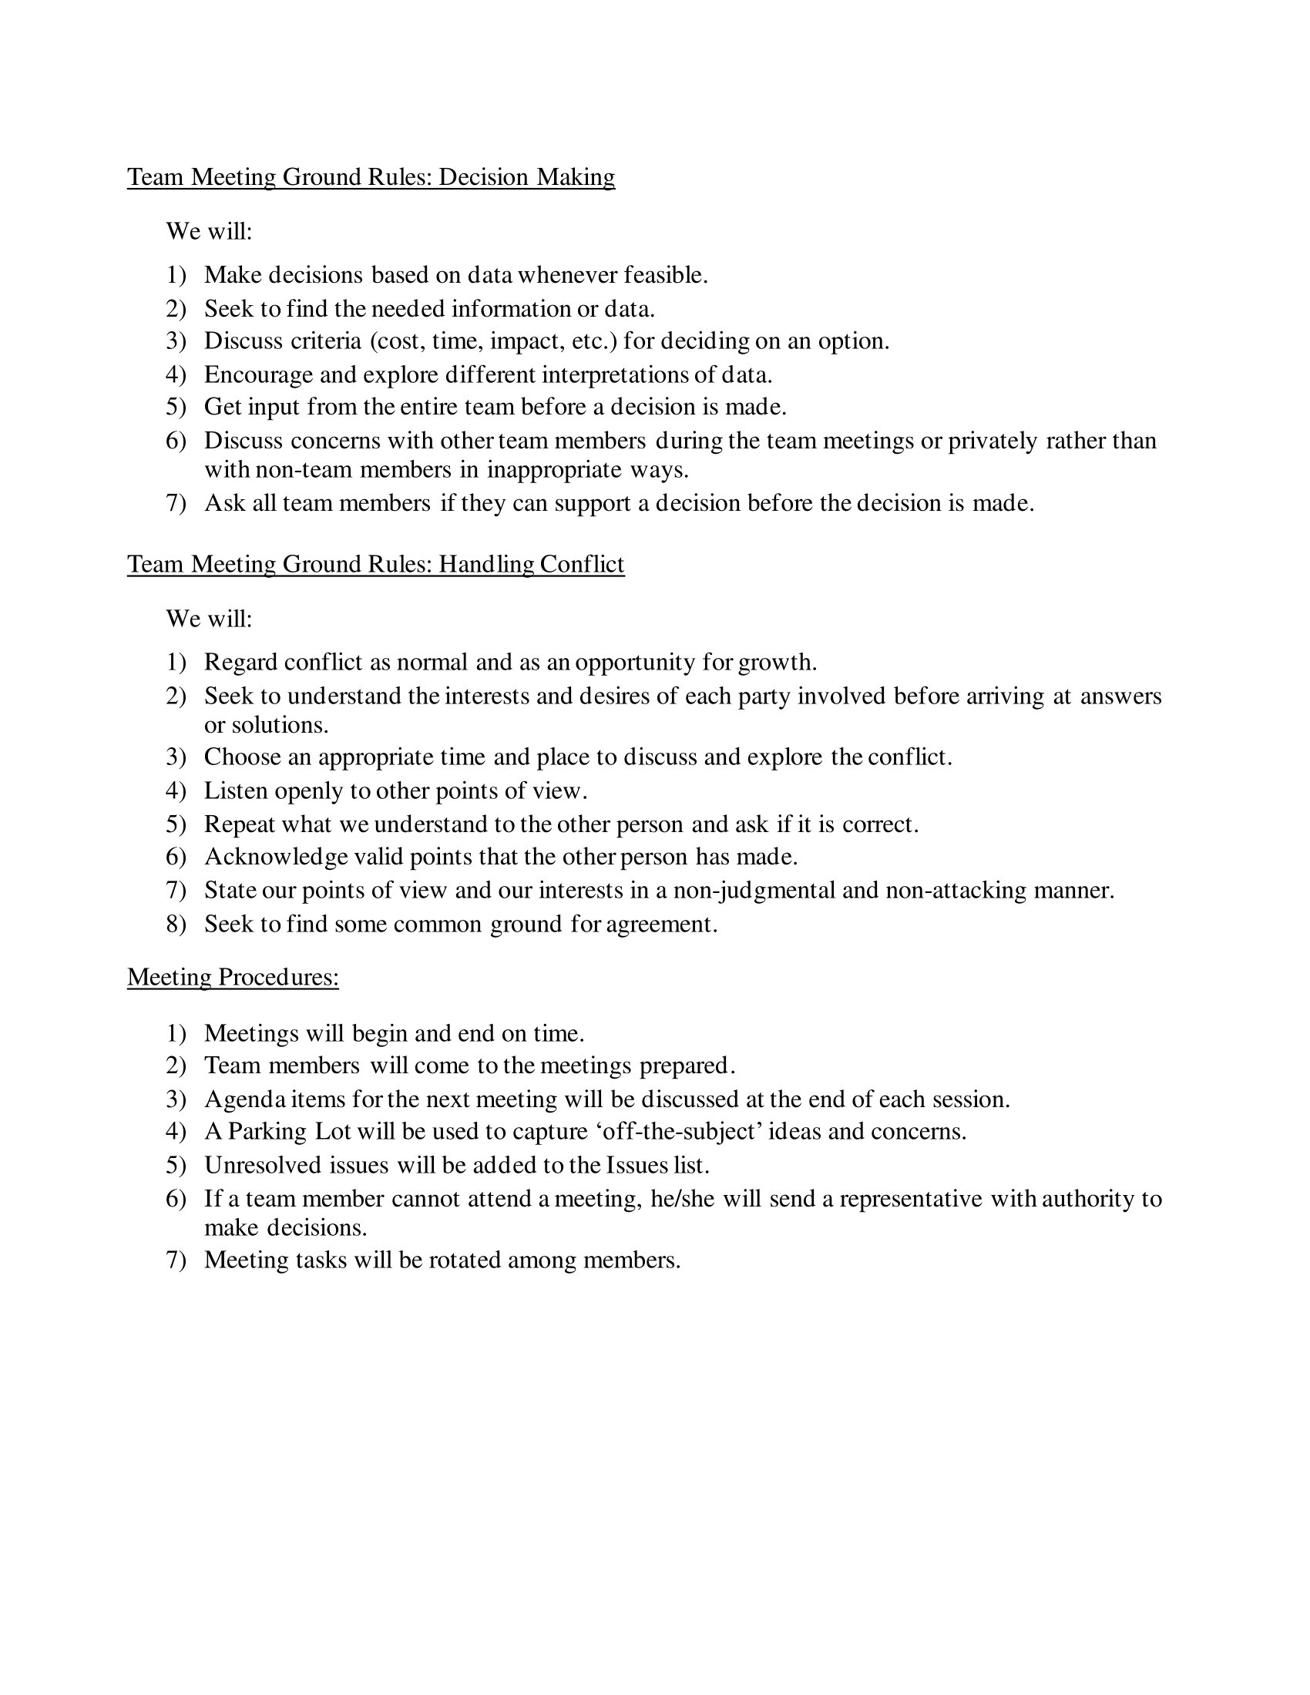

Slide 9

Personas

Slide 10
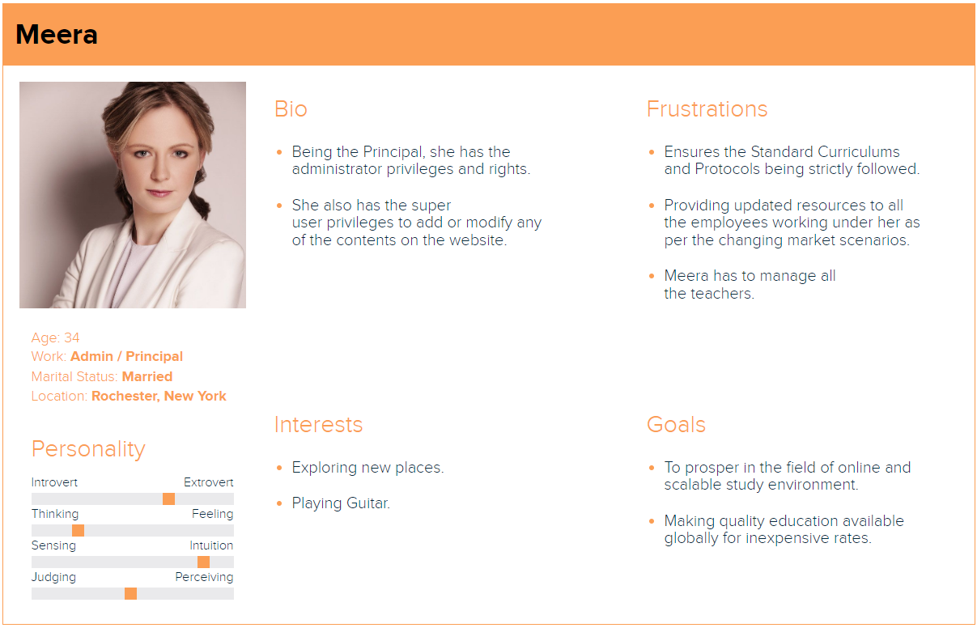

Slide 11
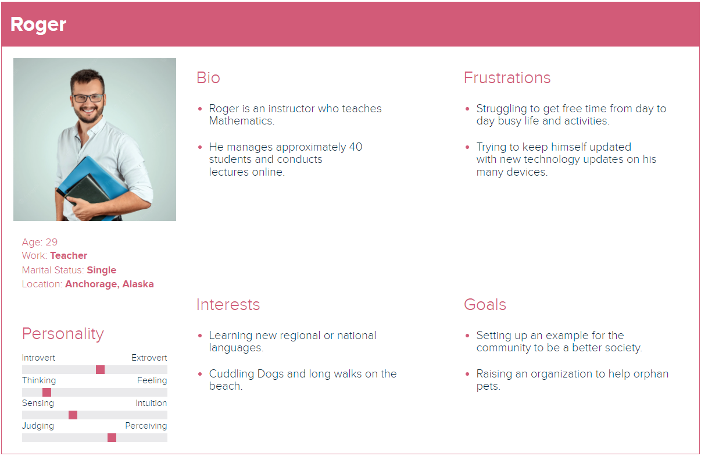

Slide 12
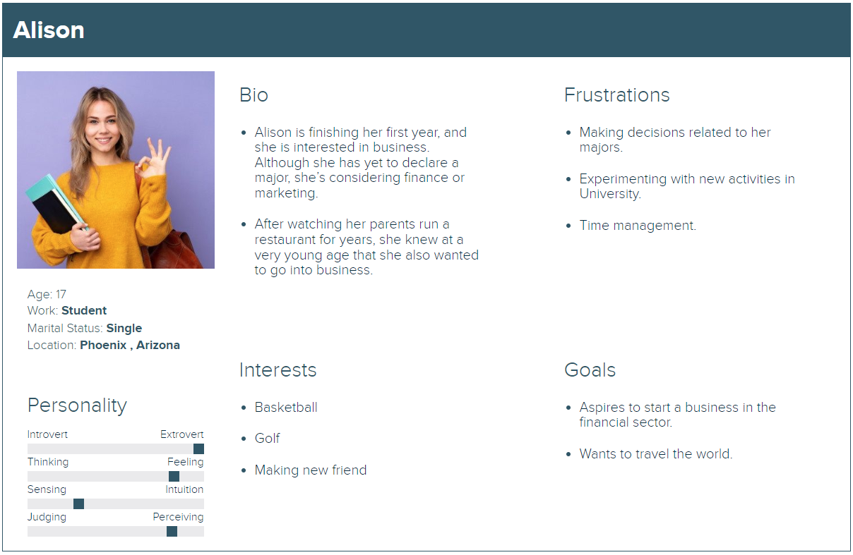

Slide 13
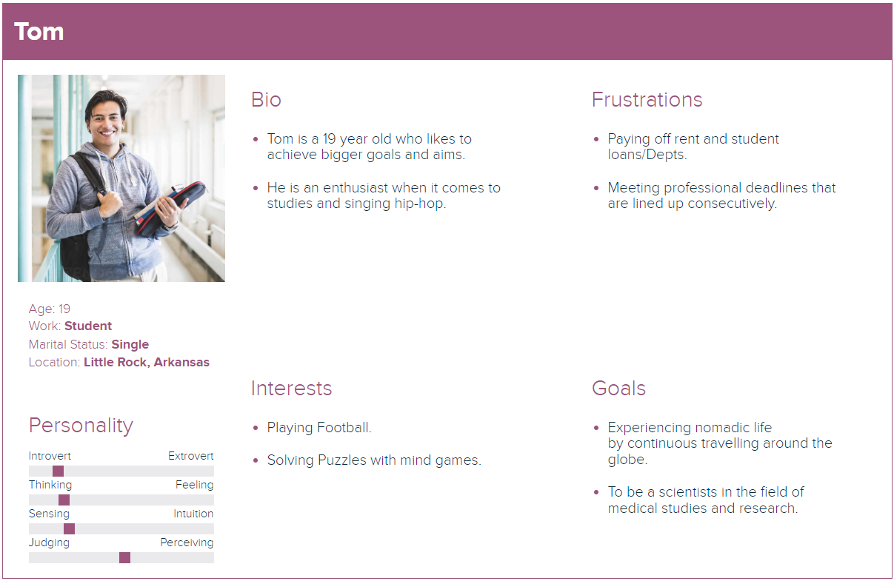

Slide 14
Minimum Viable Product (MVP)
QuickLearning MVP
Registration
Homepage
Admin Dashboard
Instructor Page
Course
Login
Search Bar
Categories
Revenue
Add/Remove Course
Logout
Top 10 Courses
Students
Courses
Add/Remove Categories
Forgot Password
Course Catalogue
Report
Payment Settings
Course Overview

Slide 15
Technologies

Slide 16
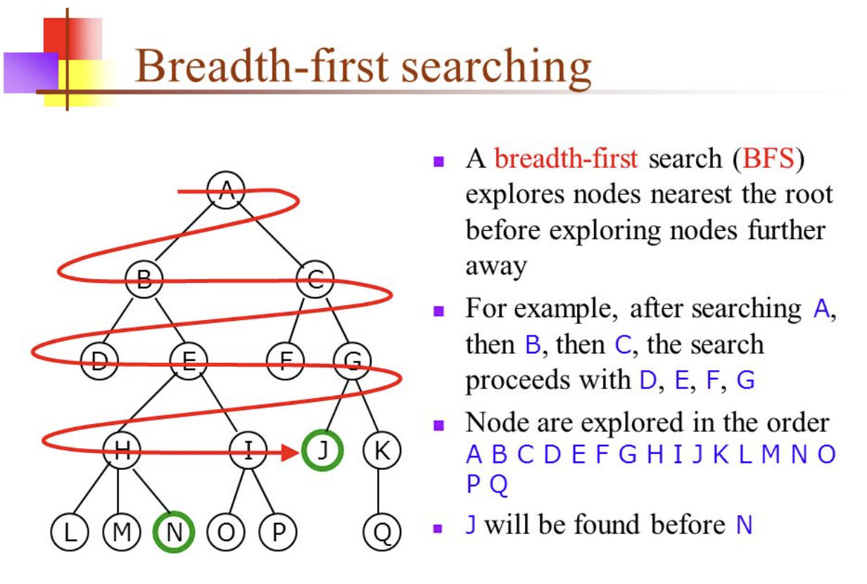
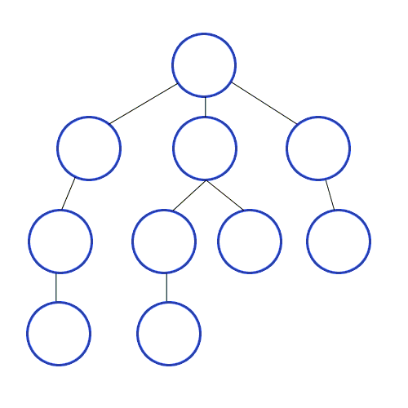
Algorithm

Slide 17

Diagrams

Slide 18
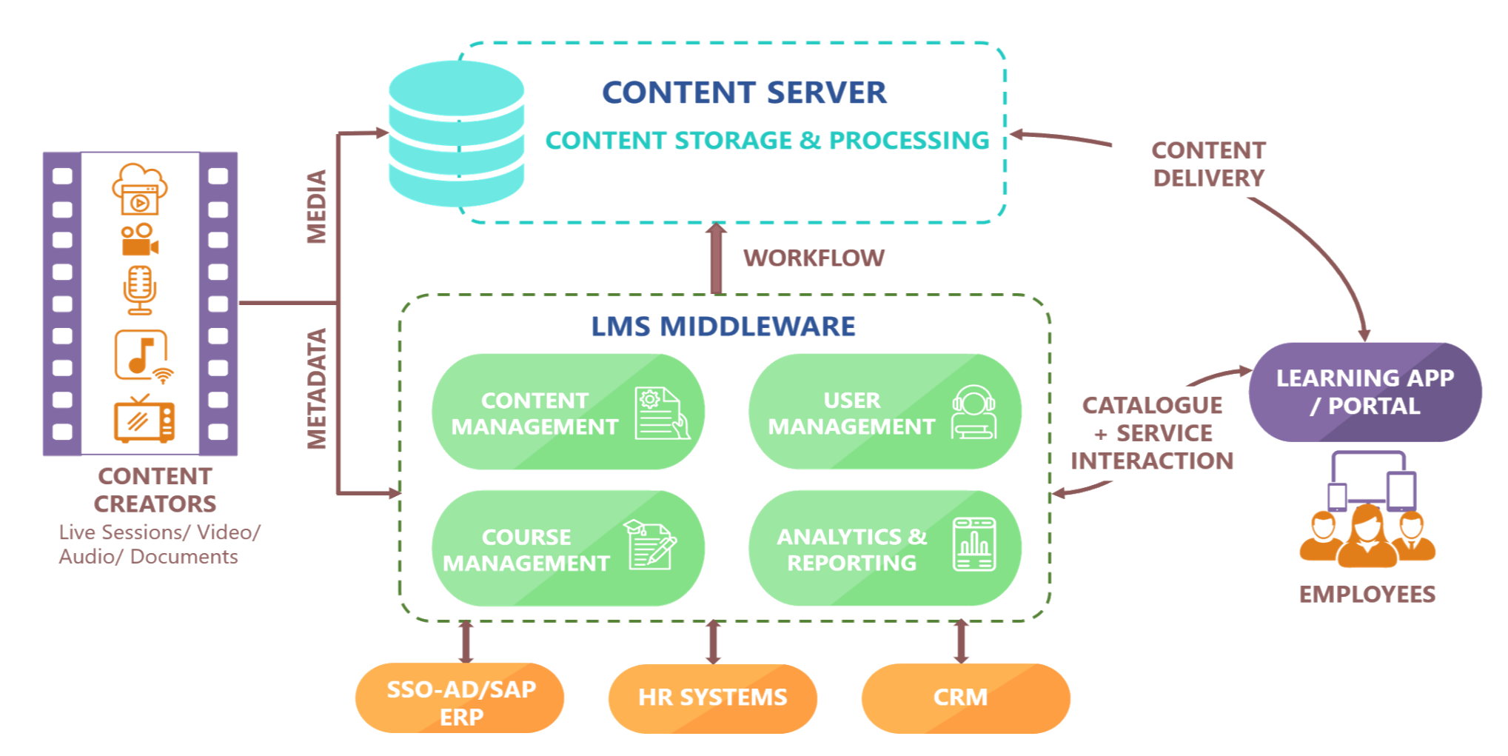
Conceptual Architecture Diagram

Slide 19
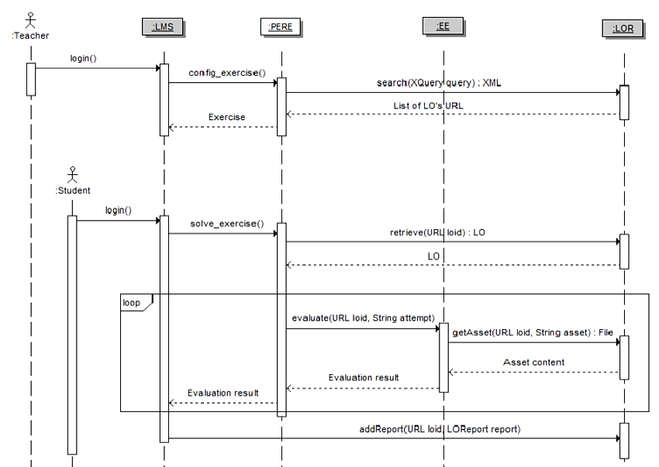
Sequence Diagram

Slide 20
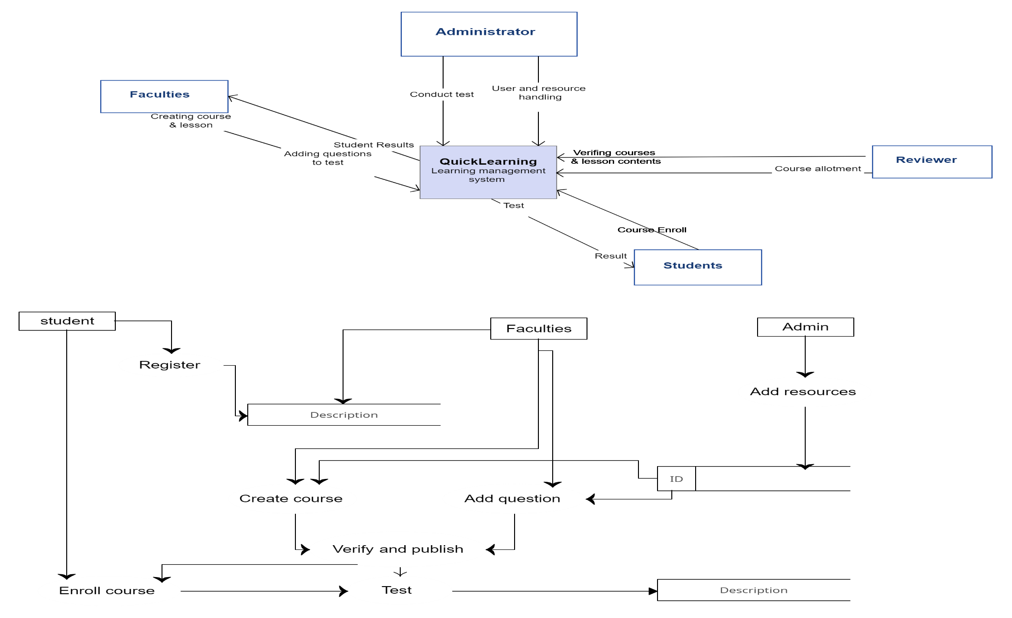
Context Diagram

Slide 21
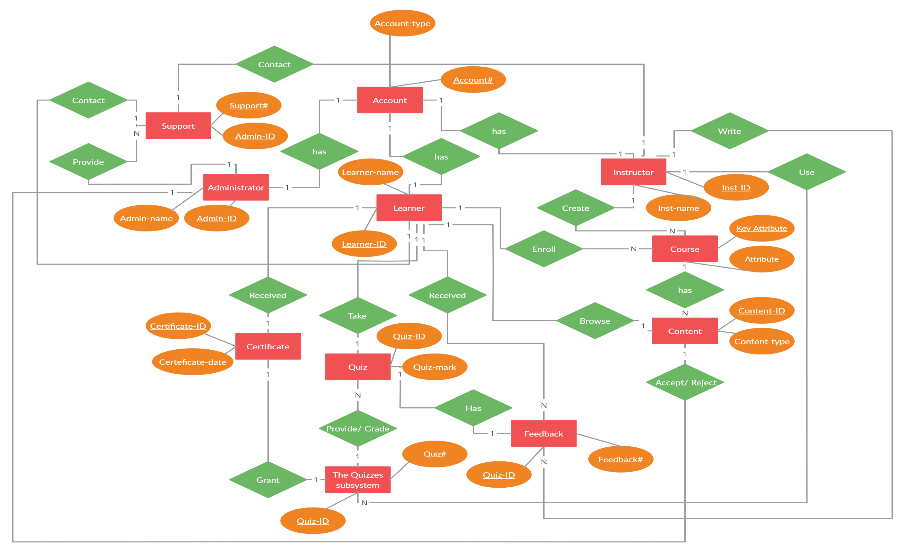
ER Diagram

Slide 22
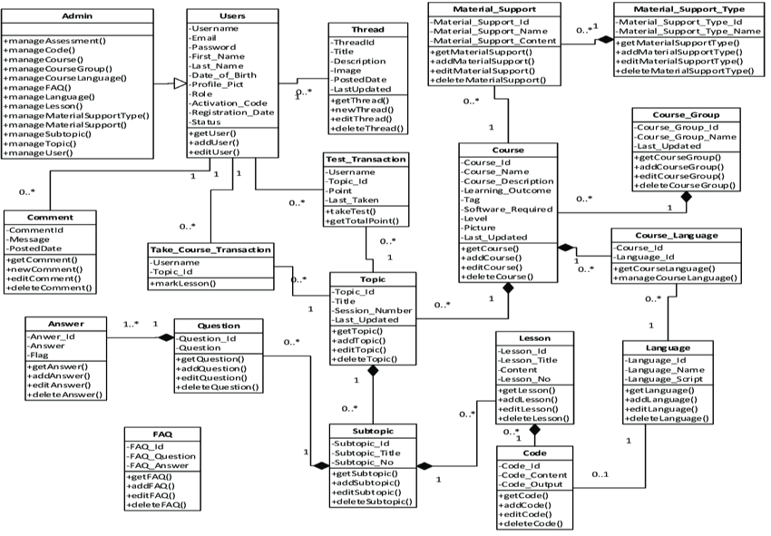
Class Diagram

Slide 23
Application Modeling
Departments, Courses, Professors, and Students list.
Maintaining and monitoring the professors and student's profile.
Communication channels.
Maintaining and monitoring courses content up-to-date.
Looking into Accounts.
Admin
Upcoming schedules.
List of courses.
Attend live classes.
Uploading course related contents.
Uploading assignments, quizzes and exams.
Give marks and feedbacks.
Monitoring the student's progress.
Conduct Study hours.
Special Classes.
Communication channels.
Quick Learning App
Authentication & Authorization
Professor
List of courses.
Weekly schedule.
Personal profile.
Upload assignments, write exams, submit quizzes.
Marks.
Achievements.
Workshops.
Badges.
Certifications.
Downloads.
Important (OR) Saved materials.
Handshake.
Communication channels.
Courses payment details.
Student

Slide 24
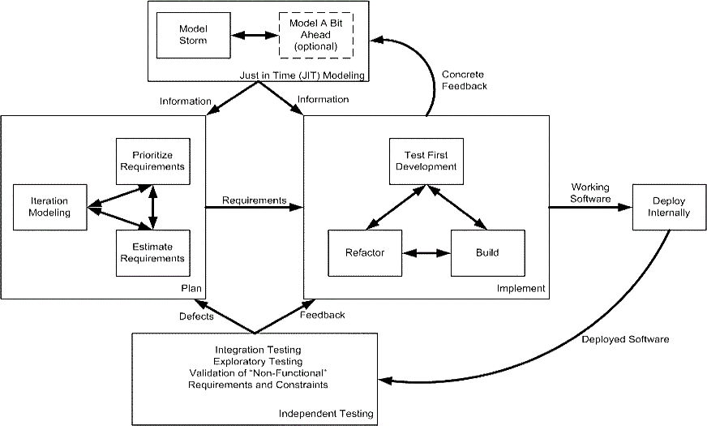
Agile Software Development Process

Slide 25
Project Recap
SignUp
Login
Logout
Create My Account
Update My Account
Forgot password
Add Course
List Course
Delete Course
Course Details
Course Wishlist​
Messages
Top 10 courses
Guest Profile
Content in my own language
Enrolment of student by Admin
Dashboard Report for Admin revenue and Instructor revenue
Revenue chart of every month in the Admin and Instructor dashboard
Categories for courses
Faster loading pages
More features to Admin Dashboard
Sprint 6 Recap
Admin enrolling the student
Admin revenue and course-wise revenue report
Professor course-wise revenue report
Add new categories

Slide 26
Product Backlog (1/2)
ID | Issue Type | Story | Status | Story Points | Priority
BREW-108 | Story | As a Student, I want to do the payment so that I can join or able to see the class of the course that I want to learn. | Done | 8 | High
BREW-112 | Story | As a User, I want to see the notifications, so that I can be able to know the updates. | Done | 5 | High
BREW-117 | Story | As a student, I want to check my grades, so that I know my progress. | To-do | 5 | Medium
BREW-132 | Story | As a Student, I want to download the materials, so that I can see them offline as well. | To-do | 3 | Medium
BREW-133 | Story | As a Professor, I want upload assignments, so that I can check the student's knowledge of my course. | To-do | 5 | Medium
BREW-134 | Story | As a Student, I want to submit assignments, so that I professor can see my answers. | To-do | 5 | Medium
BREW-139 | Story | As an Admin, I want to save my protocol, host, port, username and password, so that I can do the data transmission. | Done | 3 | High

Slide 27
Product Backlog (2/2)
ID | Issue Type | Story | Status | Story Points | Priority
BREW-140 | Story | As an Admin, I want to give Instructor and admin revenue percentage, so that admin can adjust the revenue split between admin and Instructor. | Done | 3 | High
BREW-141 | Story | As a Professor, I want to upload the grades of the students, so that they can see their progress. | To-do | 5 | Medium
BREW-142 | Story | As a Professor, I want to upload the materials of the course so that the Students can review the course material. | To-do | 3 | Medium

Slide 28
Sprint Backlog
User Story ID | Summary | Story Point
BREW-108 | As a student I want to do the payment So that I can access the course | 8
BREW-112 | As a student I want to see the notifications So that I can get periodic updates | 5
BREW-139 | As an admin I want to set SMTP setting So that I can send/receive email through the website | 3
BREW-140 | As an admin I want to set the revenue split between the admin and the instructor So that I can increase the profit of the website | 3

Slide 29
User Stories (1/2)
User Story ID | Acceptance Criteria | Status
BREW-108 | As a student I want to do the payment So that I can access the course | Done
 | Scenario the student wants to buy a course Given the student is logged in using the correct credentials When the student adds the course to his/her cart Then the student is able to purchase the course
BREW-112 | As a student I want to see the notifications So that I can get periodic updates | Done
 | Scenario the student wants to get notification regarding course Given the student is logged in using the correct credentials When the changes are made by professor Then he/she gets a notification
BREW-139 | As an admin I want to set SMTP setting So that I can send/receive email through the website | Done
 | Scenario the admin/student/professor wants to send/receive the email through the website Given the admin/student/professor is logged in using the correct credentials When the admin/student/professor wants to send/receive the email Then he/she send/receive email using this

Slide 30
User Stories (2/2)
User Story ID | Acceptance Criteria | Status
BREW-140 | As an admin I want to set the revenue split between the admin and the instructor So that I can increase the profit of the website | Done
 | Scenario the admin wants to adjust the revenue split Given the admin is logged in using the correct credentials When the admin opens the dashboard Then he/she can make changes to the revenue model

Slide 31
Test Cases

Slide 32
Stories Completed and Stories Not Completed
User Story ID | Summary | Story Point | Status
BREW-108 | As a student, I want to do the payment, So that I can access the course | 8 | Completed
BREW-112 | As a student, I want to see the notifications, So that I can get periodic updates | 5 | Completed
BREW-139 | As an admin, I want to set SMTP setting, So that I can send/receive email through the website | 3 | Completed
BREW-140 | As an admin, I want to set the revenue split between the admin and the instructor, So that I can increase the profit of the website | 3 | Completed

Slide 33

Metrics

Slide 34
Team Velocity Chart
25
20
15
10
5
0
Sprint 1
Sprint 2
Sprint 3
Sprint 4
Sprint 5
Sprint 6
Sprint 7

Slide 35
Team Historical Velocity (Average)
25
23
20
19
15
15
14
14
13.85
10
7
5
5
0
Sprint 1
Sprint 2
Sprint 3
Sprint 4
Sprint 5
Sprint 6
Sprint 7
Average

Slide 36
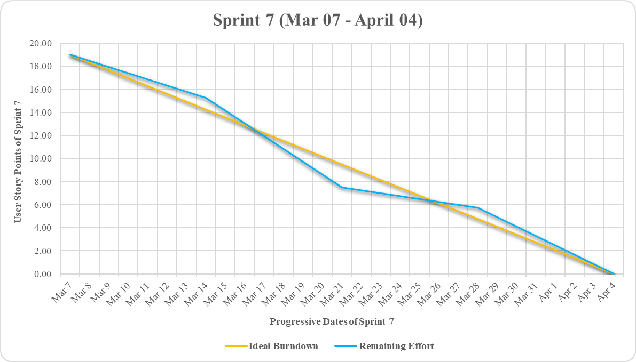
Burndown Chart

Slide 37
Committed Against Completed Ratio
Sprint Number | Committed | Completed
Sprint 1 | 5 | 5
Sprint 2 | 7 | 7
Sprint 3 | 15 | 15
Sprint 4 | 14 | 14
Sprint 5 | 14 | 14
Sprint 6 | 23 | 23
Sprint 7 | 19 | 19
Committed
100%
Completed
100%

Slide 38

Retrospective

Slide 39
What went well?
Team members had open and sincere conversations about how to improve together as a team. This is an important aspect of building a strong team dynamic.
Transparency in communication helped in build a united team and developed a shared expectation.
Deep involvement and awareness of the team members gave unexpected valuable results.
Going experimental with our process by trying new things frequently and holding regular retrospectives to validate our experiments.
Working smarter and seeing solutions evolve through collaboration.

Slide 40
What did not go well?
We lacked Proactive problem-solving skills and quick resolution of technical challenges was critical for maintaining sprint timelines.
Our testing process was not as efficient as we hoped, which resulted in some last-minute bug fixes.
We could not estimate the subtasks that occurred during the sprint.

Slide 41
What needs improvement?
Establish a process for proactive problem-solving to minimize delays.
We can improve our testing process by involving QA earlier in the development process.
We should estimate all the sub task at the starting of the sprint.

Slide 42
Stories Planned and Committed for Sprint 8
User Story ID | Stories | Status
BREW-117 | As a student, I want to check my grades, so that I know my progress. | To-do
BREW-132 | As a Student, I want to download the materials, so that I can see them offline as well. | To-do
BREW-133 | As a Professor, I want upload assignments, so that I can check the student's knowledge of my course. | To-do
BREW-134 | As a Student, I want to submit assignments, so that I professor can see my answers. | To-do
BREW-141 | As a Professor, I want to upload the grades of the students, so that they can see their progress. | To-do
BREW-142 | As a Professor, I want to upload the materials of the course so that the Students can review the course material. | To-do

Slide 43

Slides App Screenshot

Slide 44
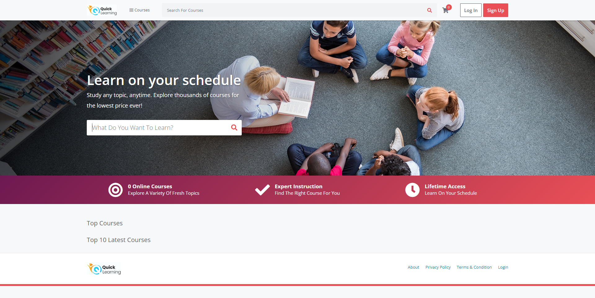
Home Page with Search Bar to search for courses

Slide 45
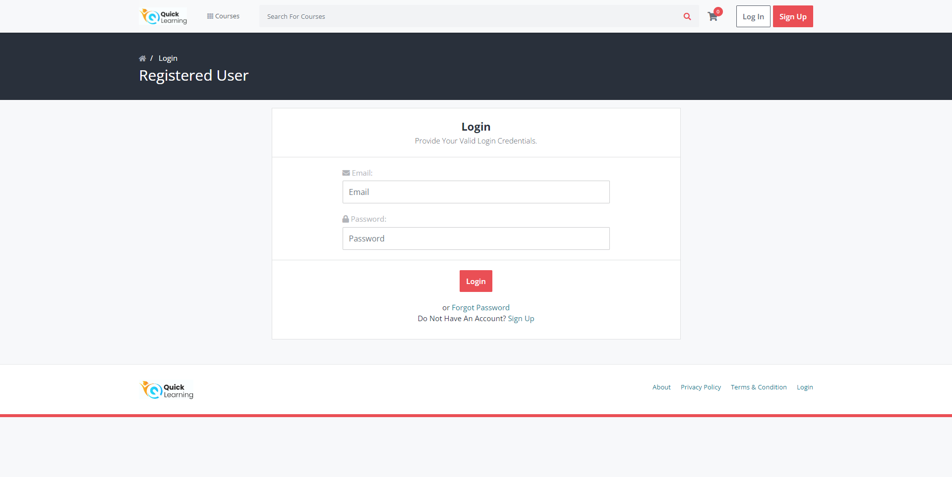
Login Page

Slide 46
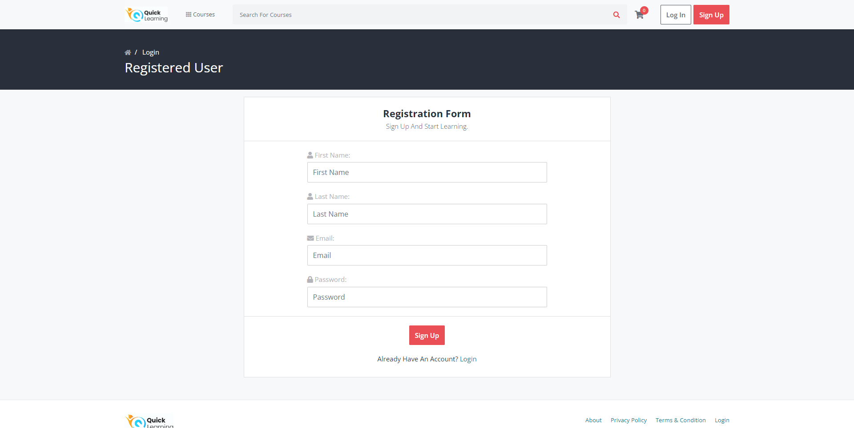
SignUp Page

Slide 47
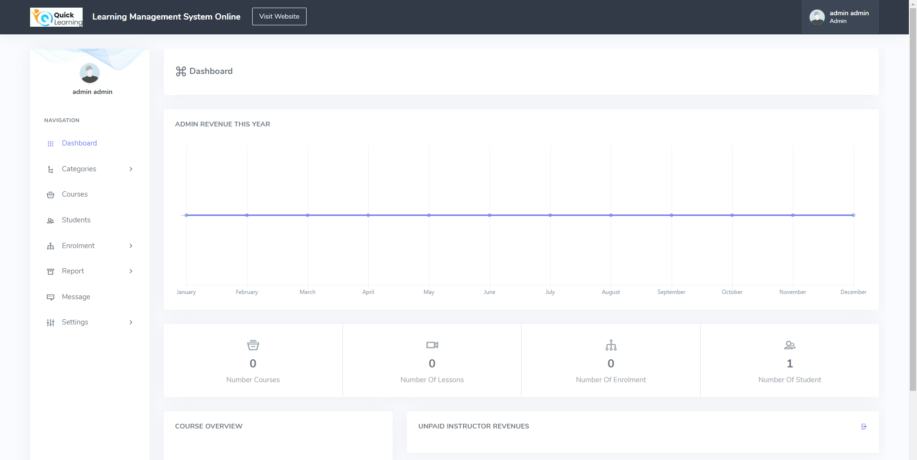
Admin Dashboard

Slide 48
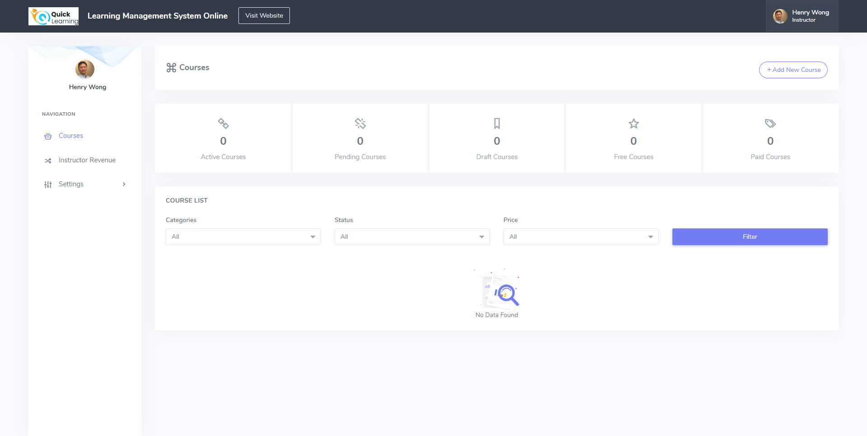
Instructor/Professor Dashboard

Slide 49
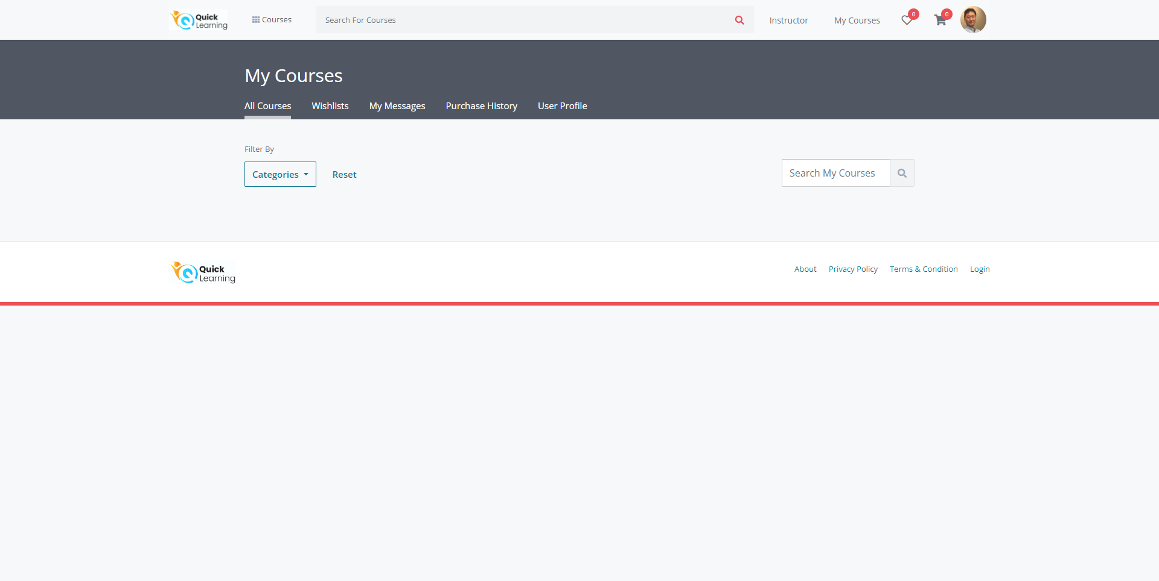
My Courses Page

Slide 50
Visit our WikiLink
https://github.com/htmw/QuickLearning/wiki
https://github.com/BrewingTechnologies/QuickLearning/wiki

Slide 51

Live Application Demo

Slide 52
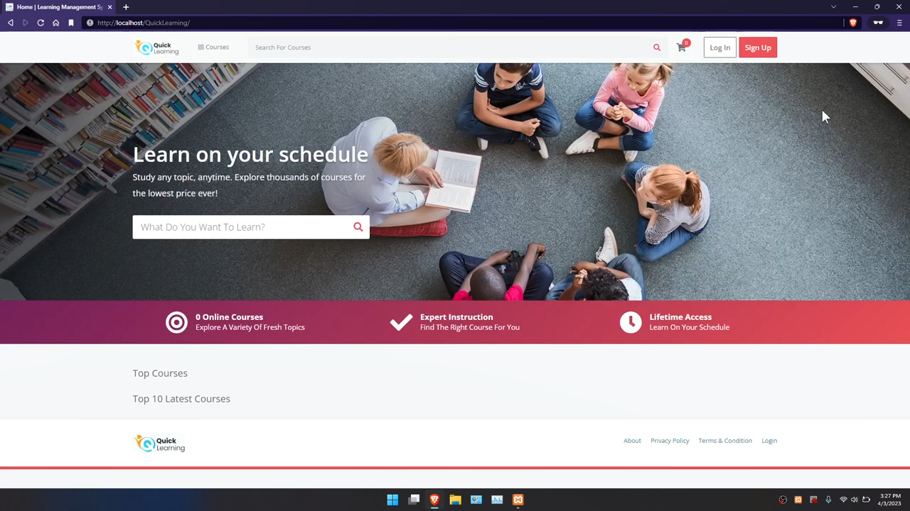

Slide 53

Happy Learning! Thank You for your patience and attention!

